Slide 1
AI-Based SYMPTOM SEVERITY ANALYZER & INTELLIGENT MEDICINE RECOMMENDATION SYSTEM
Presented By:
Student Name- Rafkhan B
College Name- UIT Neyyatinkara, TVM
Department- BSC Computer Science

Slide 2
OUTLINE
Problem Statement
Proposed System/Solution
System Development Approach
Algorithm & Deployment
Datasets Used
Result
Conclusion
Future Scope
References

Slide 3
Problem Statement
Many people experience health symptoms but are unable to identify the disease and its seriousness at an early stage. Due to lack of medical awareness, doctor availability, and cost, early diagnosis and timely treatment are delayed.
There is no integrated intelligent system that can :
  Analyze multiple symptoms
  Predict possible disease
  Assess severity level
  Suggest safe medicines and precautions

Slide 4
Proposed Solution
The proposed system is an AI-powered clinical decision support system that:
  Predicts diseases from symptom combinations
  Evaluates severity and emergency risk
  Provides medical description and safety precautions
  Recommends appropriate medicines with substitutes
  Assists in early health awareness and decision-making

Slide 5
System Approach
The system follows a web-based AI architecture:
  User selects symptoms via a web interface
  Machine Learning model predicts disease
  Severity scoring engine evaluates risk
  Knowledge base provides disease description and precautions
  Medicine recommendation module suggests treatment
  Output displayed in real time using Streamlit

Slide 6
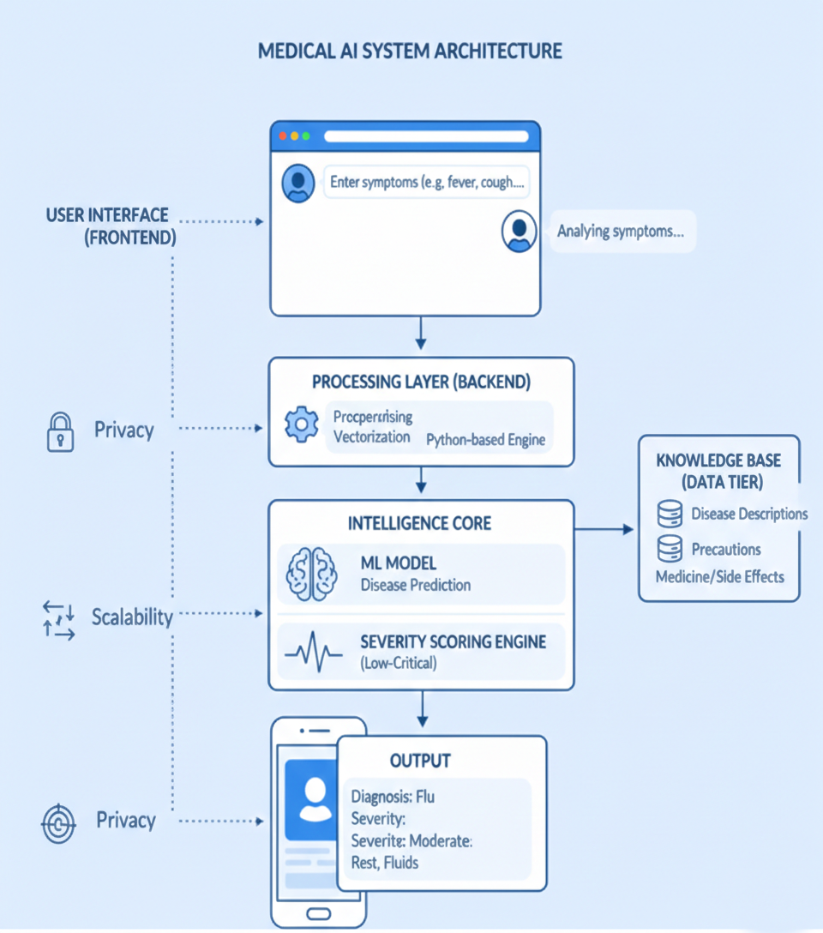
Algorithm & Deployment
Algorithm Steps:
Accept multiple symptoms from user
Preprocess and vectorize symptoms
Predict disease using trained ML model
  Model: Multiclass Classification using Scikit-learn
  Vectorization: TF-IDF
Calculate severity score using symptom weights
Classify risk level (Low, Moderate, High, Critical)
Retrieve disease description and precautions
Recommend suitable medicines and substitutes
Deployment:
Developed using Python & Streamlit
Runs locally or can be deployed on cloud platforms
.

Slide 7
DATASETS USED
Disease-Symptom Dataset
Symptom Severity Dataset
Disease Description Dataset
Precaution Dataset
Medicine Usage & Slide Effect Dataset

Slide 8
Result
Accurate disease prediction for common illnesses
Correct severity classification
Real time response through web interface
Medicine suggestions with side-effect awareness
User-friendly and professional clinical dashboard

Slide 9
Conclusion
The project successfully demonstrates how Machine Learning and Medical Knowledge Bases can be combined to build an intelligent healthcare assistant.
It provides early disease prediction, severity analysis, and treatment guidance, supporting timely medical decisions.
This project highlights the potential of AI in creating accessible and human-centered clinical decision support solutions (CDSS).

Slide 10
Future scope
Deep Learning models for higher accuracy
Medical image analysis (X-ray, MRI)
Voice-based symptom input
Patient history tracking
Drug interaction detection
Mobile application development

Slide 11
References
Kaggle Datasets
  Disease Symptom Prediction
  250k Medicines Usage, Side Effects and Substitutes
Scikit-learn Documentation
Streamlit Documentation
WHO Symptom & Disease Resources
Research Papers on Clinical Decision Support Systems (CDSS)

Slide 12
Github link
Github Link : https://github.com/Rafkhan01/AI-healthcare-system.git
Deployment Link: https://ai-healthcare-system-jaqgrqbayym7wsnbmvr4kf.streamlit.app/

Slide 13
THANK YOU

